Slide 1



VISHWAKARMA INSTITUTE OF TECHNOLOGY

Slide 2
VISHWAKARMA INSTITUTE OF TECHNOLOGY
Case-Study: Pi (𝜋) as an Infinite Series
By
Abhishek
Abhishek
Adit
Abhinandan
Pradyumna
Aditi
Prof: Pooja Wanjale

Slide 3


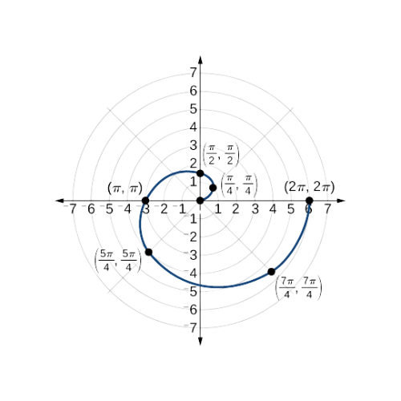
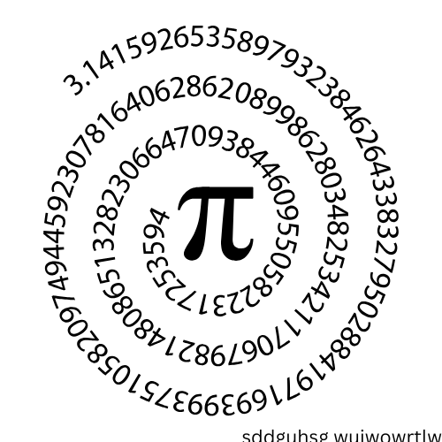
INTRODUCTION
Radius
-------------------------------
Diameter
Circumference
The number π (pi) is one of the most remarkable and mysterious constants in mathematics. Defined as the ratio of a circle’s circumference to its diameter, it appears everywhere—from geometry and trigonometry to physics and engineering. In this presentation, we will explore how π is represented through infinite series, revealing its profound connections with calculus and the concept of infinity. By examining these series, we gain insights into the precision and elegance of mathematics, showcasing the timeless beauty of π.

Slide 4
INTRODUCTION
Radius
The number π (pi) is one of the most remarkable and mysterious constants in mathematics. Defined as the ratio of a circle’s circumference to its diameter, it appears everywhere—from geometry and trigonometry to physics and engineering. In this presentation, we will explore how π is represented through infinite series, revealing its profound connections with calculus and the concept of infinity. By examining these series, we gain insights into the precision and elegance of mathematics, showcasing the timeless beauty of π.
-------------------------------
Diameter
Circumference

